Slide 1

Data Science for Understanding
Session 1

Slide 2
Business Problem of Prediction
“Given X, what does the future hold for Y?” e.g., predicting server bandwidth from date, time, etc.
What kinds of problems are we solving now?

Slide 3
Business Problem of Prediction
Accurate prediction Limited understanding?
Notes:
Limits to prediction
- Don’t

Slide 4
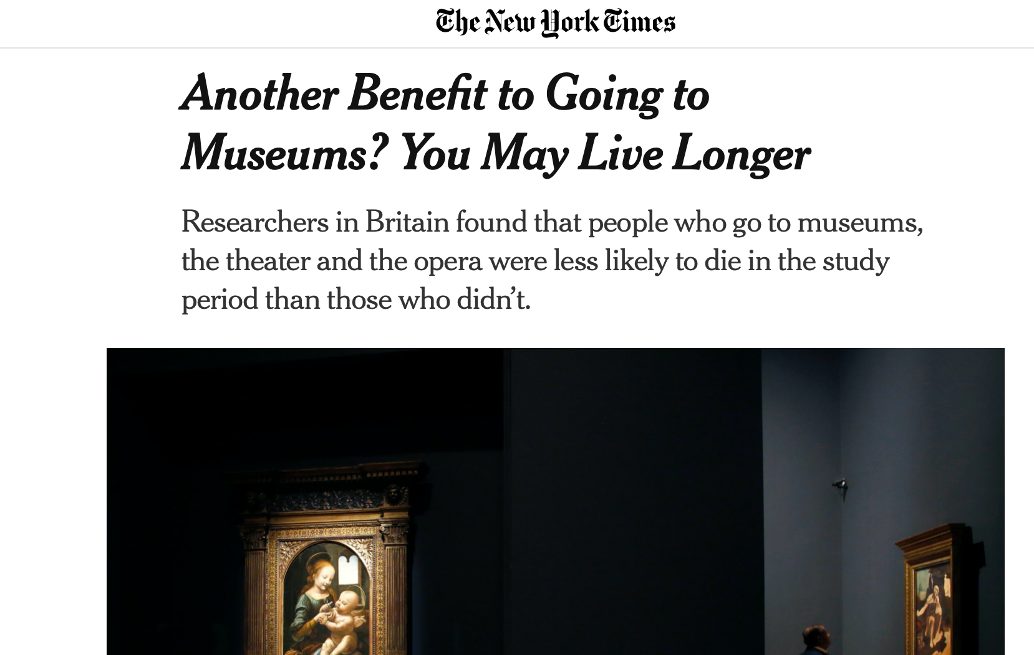
Prediction ≠ Understanding
https://www.nytimes.com/2019/12/22/us/arts-health-effects-ucl-study.html
Notes:
Just because something predicts does not mean that it’s causal. What’s going on here? Clearly MAKING PEOPLE START GOING TO MUSEUMS WON’T ACTUALLY HELP THEM

Slide 5
Stages of Scientific Understanding
Description
Explanation
Prediction
Control
Notes:
Data science is fundamentally a science about people, so let’s take a look at what “people scientists” do when they think about trying to build a science of human behavior
Control is A goal. This is what we WANT TO KNOW. If I do X, can I reliably say what will happen?
Explanation A goal. If I und
- Scientists assume you would NEVER be able to predict without an explanatory model. Where would you get the data?

Slide 6
Stages of Scientific Understanding
Description
Explanation
Prediction
Control
How do you know which variables to use in a predictive model?
Notes:
Discussion Q
You actually DO have a “theory” of how “X” works (often wrong?)
We can supercharge our prediction by understanding how “X” works

Slide 7
Business Problem of Understanding
“How does this work?” “Why do customers do X?” e.g., understanding why people like some games but not others
Notes:
Going to sell you on this

Slide 8

“There is nothing so practical as a good theory”
- Kurt Lewin
Notes:
Good Theory = correct understanding, such that you can rely on it

Slide 9
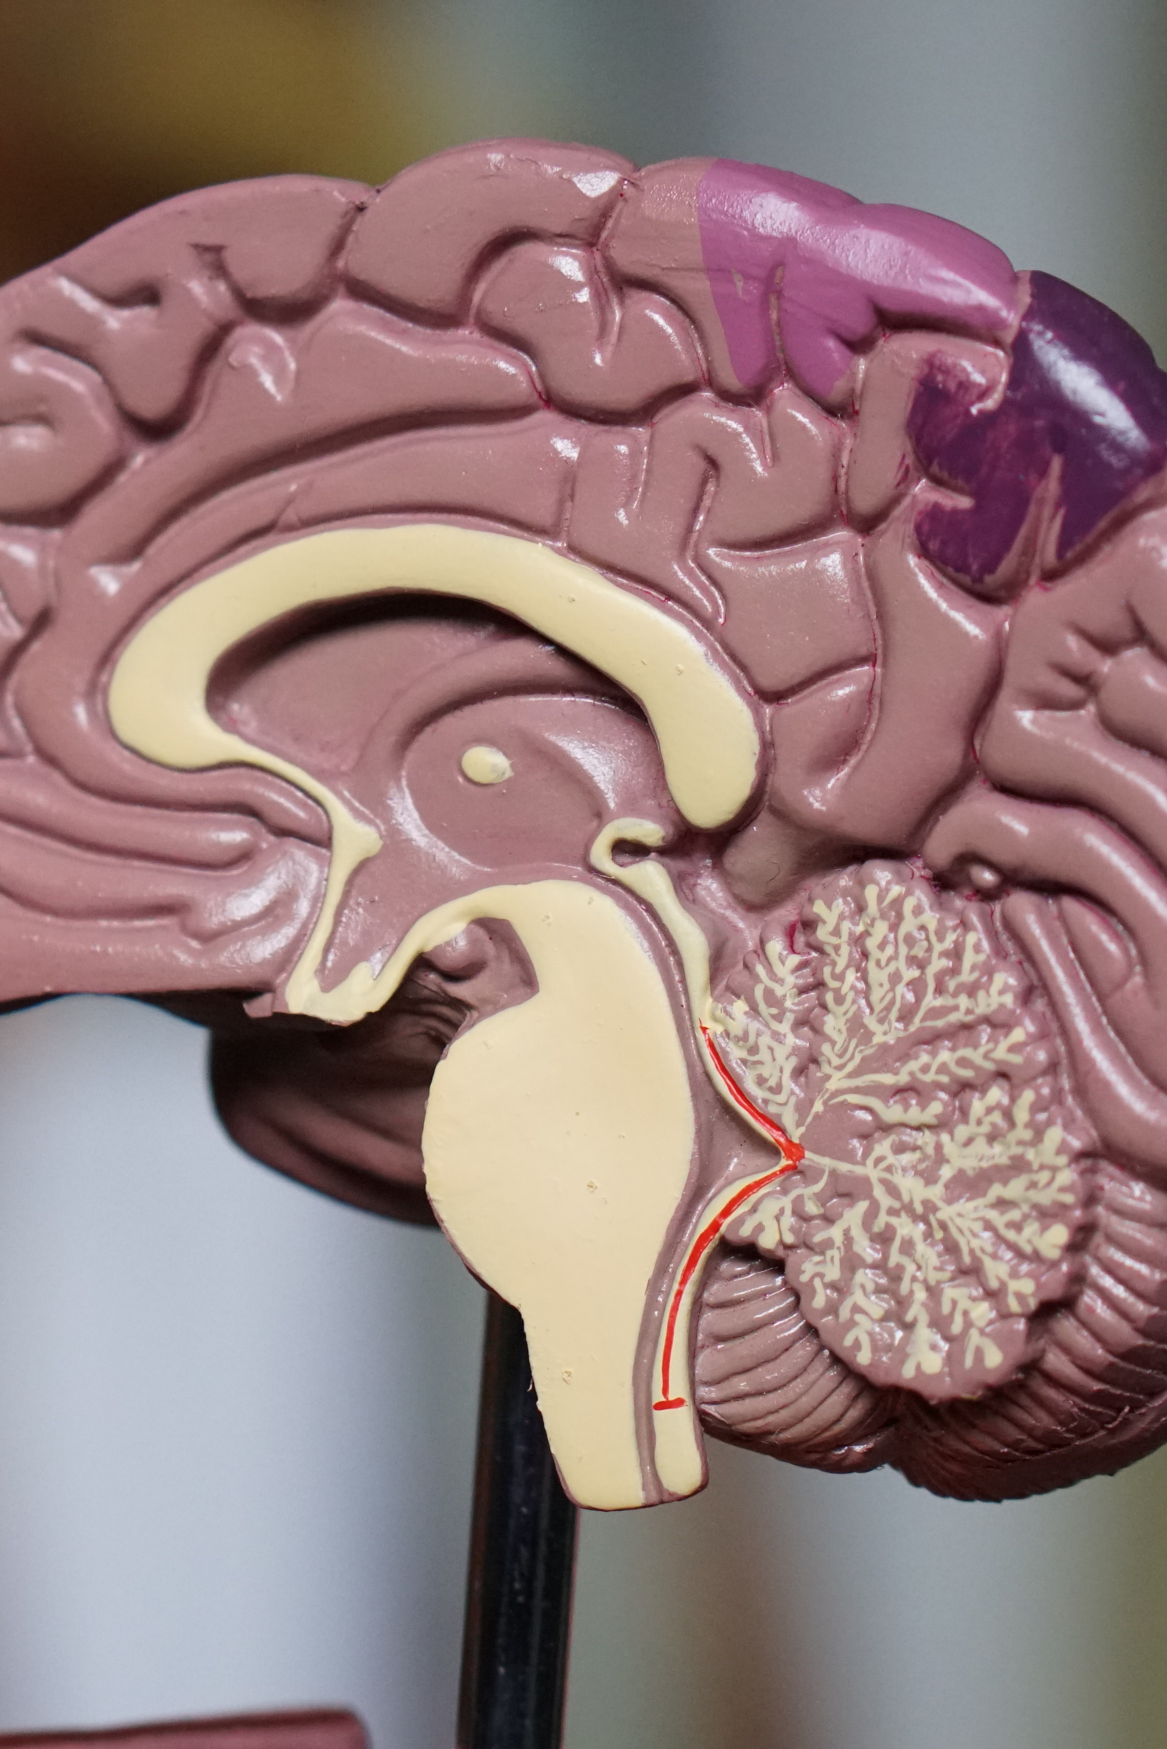
Understanding You Can Rely On
Build better models
Know what data to collect
Manage, intuit, and think critically about business problems
Enables action
Notes:
Machines can think for us sometimes and that’s ok
Understanding facilitates action. Gets us to that control stage.
All data scientists modeling human behavior must therefore be psychological scientists

Slide 10
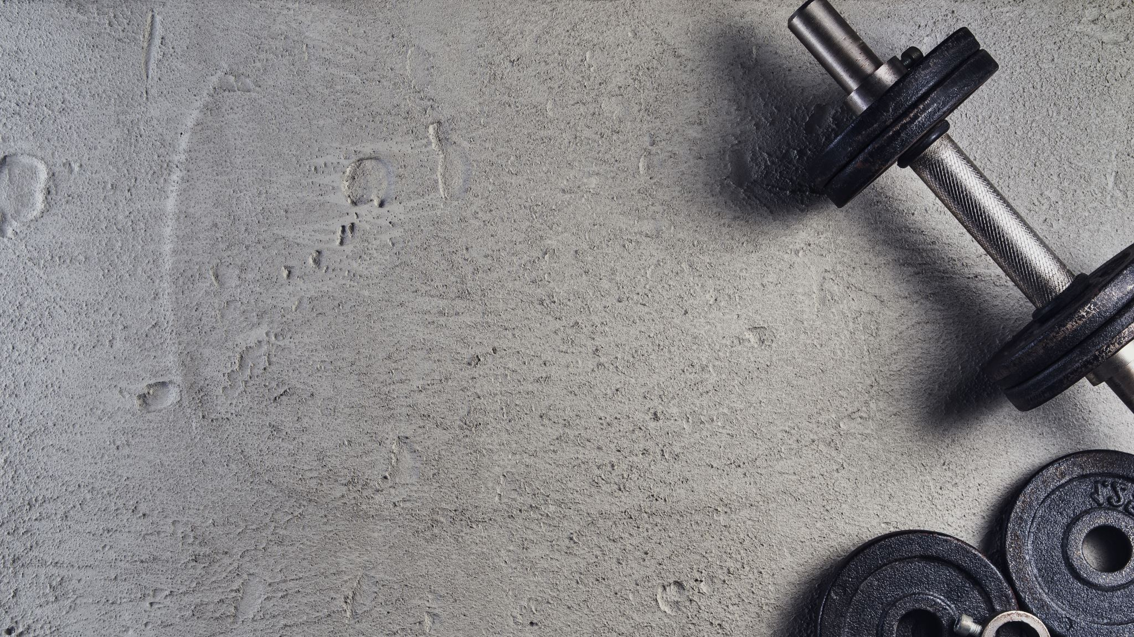
Teams Exercise
Notes:
Find the false discovery rate for various situations. Do a simulation to show that it’s real.

Slide 11
Teams Discussion #1
Develop a theory of what makes a game fun to play
What are the causes of fun?
What are the effects of fun?
Can you think of ’universal principles’ (vs. things that vary across game types, gamer segments)?
Can you think of things that would vary across segments? How?

Slide 12

Process

Slide 13
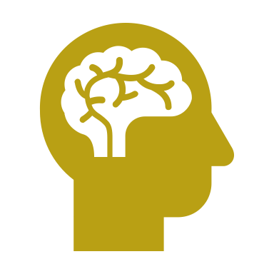
Conceptual Understanding
Collect & Process Data
The Python logo is a trademark of the Python Software Foundation, used in accordance with PSF’s trademark use policy.

Slide 14

Example
Problem → Question to Answer
Pitch an Explanation (Theory)
Design an Experiment / Analysis to Test
Draw Conclusions
Repeat, Hone on Answer
Solve Problem
Notes:
Make this interactive
Step 1: Identify the problem: (water leaking in basement)
Step 2: Frame problem as a question to be answered (what is causing the leak?)
Step 3: Generate a theory as to the answer to the question (a pipe is leaking).
Step 4: Observe and experiment in ways that speak to the theory.
Goal: ‘severe test’ that would either affirm or falsify the theory.
Observe: someone is in the shower above.
Experiment: turn off the shower. Result: water leak continues for a while, then stops.
Step 5: Revise theory: pipe leak seems like a poor fit to the data. Perhaps the leak is in the shower piping?
Step 6: iterate the cycle until a final answer is confirmed
Experiment: turn on the shower (empty shower). No leak.
Revise theory: maybe the problem is water leaking through the shower wall/tile.
Experiment: turn on shower with person in it until a leak appears. Assess where water is. Result: water primarily on the ‘wet wall’ [wall with shower controls].
Revise theory: so maybe that wall is leaking.
Experiment: have someone in the shower but cover that wall with a tarp [no leak]. Remove tarp [leak starts].
Step 7: final answer confirmed. That wall needs replacing because it is leaking.

Slide 15
Teams Exercise
Notes:
Find the false discovery rate for various situations. Do a simulation to show that it’s real.

Slide 16
Teams Discussion #2
Revisit your team’s theory/understanding of what makes a game fun to play
Identify 3-4 results or observations you would expect if the theory was correct
Identify 3-4 results or observations you would expect if the theory was incorrect

Slide 17
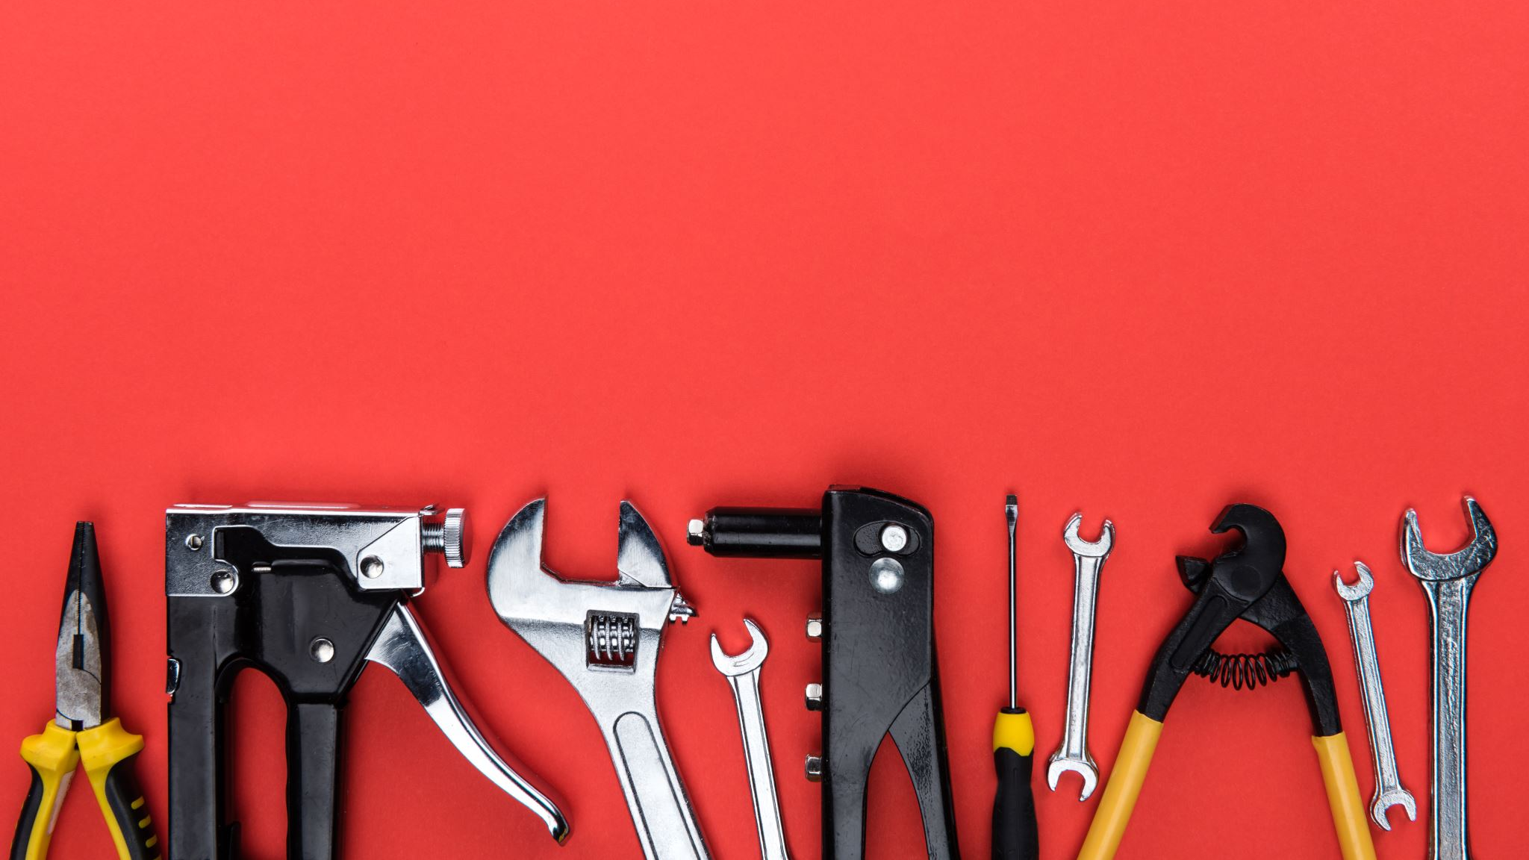
Tools

Slide 18
Designs for Understanding
The Experimental Approach
The Observational Approach
Notes:
We used both of these earlier to great effect in the water leak idea

Slide 19
Designs for Understanding
The Experimental Approach
The Observational Approach
Now
After Lunch
Notes:
We used both of these earlier to great effect in the water leak idea

Slide 20
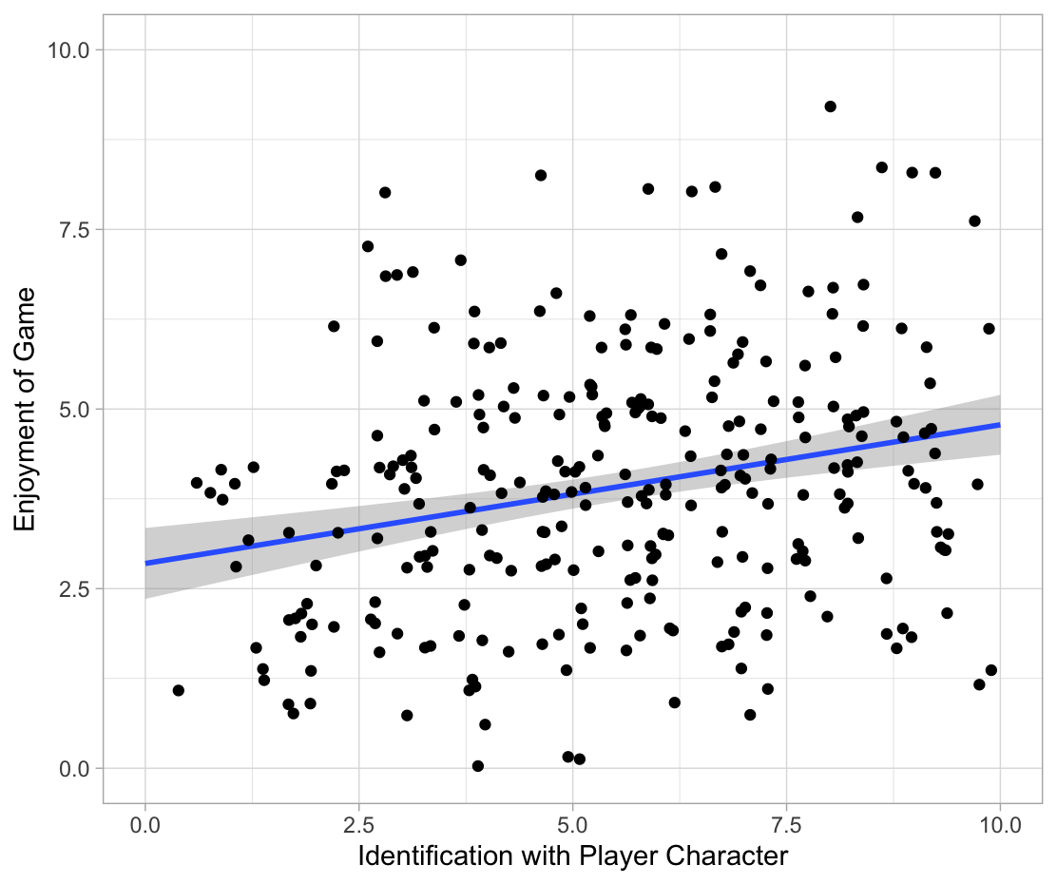
Observational
Use one observed variable to predict another
Brainstorm: Why Might These Correlate?

Slide 21

Strengths for Understanding
Naturally occurring* (external validity)
On the trail: something caused something
Notes:
We have real-world, naturally occurring data, behavior, etc. That’s good. Must beware of selection bias though!

Slide 22
Weaknesses?
Correlation ≠ causation
Can be absent with causation
Can be present without causation
Meaning is … difficult
Notes:
Example that covers both: apology should make it easier to forgive someone, right? Yet more apology is associated with LESS forgiveness. Why? Because people apologize for worse things.
Also easy to hack
Meaning: can you tell me what’s going on there? That’s world happiness data from the UN. Big circles are positive correlations. Sometimes “everything correlates with everything” and it’s hard to say what it means.

Slide 23
3 Reasons for Correlation!
Causation
Reverse Causation
Confound
Identification → Enjoyment
Identification ← Enjoyment
Rule out: establish time-order
Identification Enjoyment Other Stuff
Rule out: hold confounds constant

Slide 24
Python Exercise
Notes:
Find the false discovery rate for various situations. Do a simulation to show that it’s real.

Slide 25
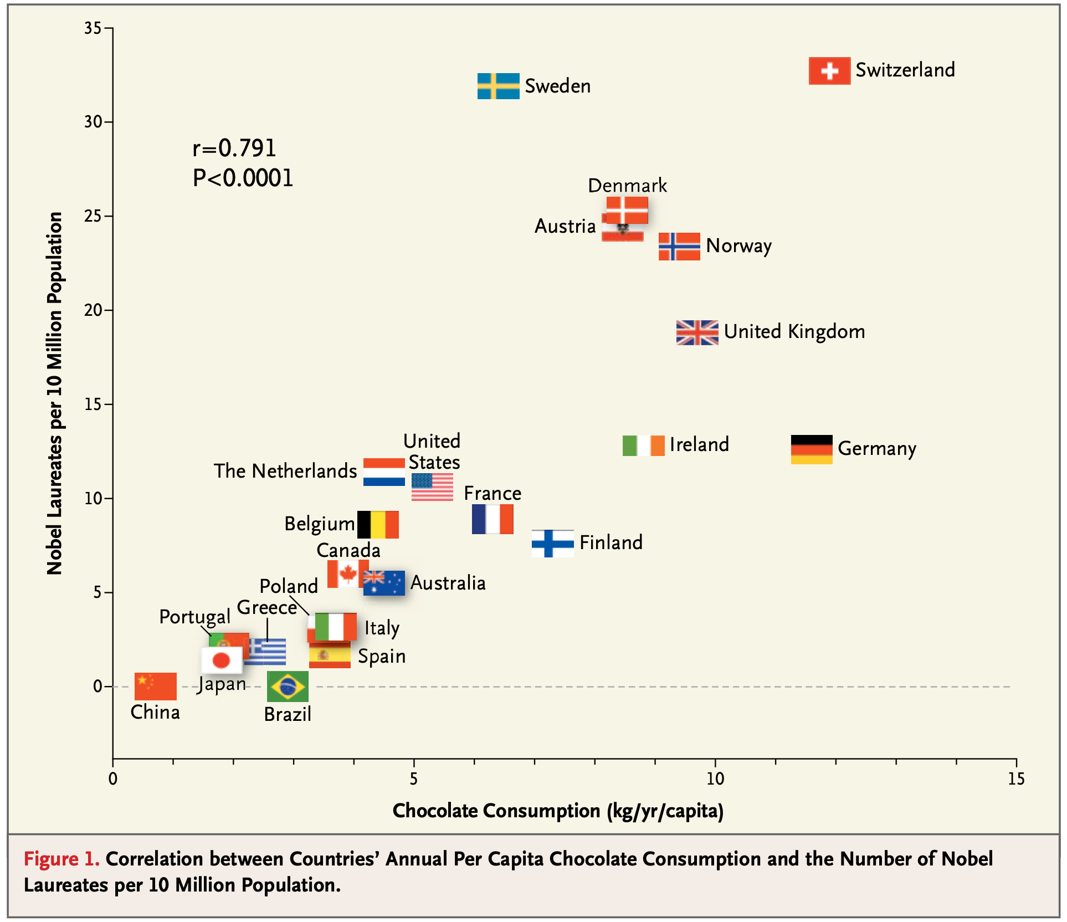
Nobel Chocolate Activity
Messerli, Franz H. “Chocolate Consumption, Cognitive Function, and Nobel Laureates.” The New England Journal of Medicine; Boston 367, no. 16 (October 18, 2012): 1562–64.

